Slide 1
Clinician-in-the-Loop AI Decision Support for Depression Risk
Project Type: Innovation Driven (INN)
Asad Raza (D03000182)
Syed Jahanzaib Ali Zaidi (D03000193)

Slide 2
Problem Statement
Mental health assessment is a safety-critical clinical process
Incorrect or premature automation can cause serious harm
Clinicians face increasing cognitive and time pressure
AI has potential, but misuse introduces ethical and safety risks

Slide 3
Objectives
01
02
03
04
Provide probabilistic risk indicators, not diagnoses
Preserve human decision authority
Enable real deployment and reproducibility
Ensure safety, fairness, privacy, and robustness

Slide 4
System Implementation
React
MongoDB
Node.js
FrontEnd for clinical interaction
For Patient and Session history
Central orchestration component
Fast API
JWT Tokens
Docker
AI Inference service to call pre-trained ML model
Authorization check
Used to run MongoDB

Slide 5
Deployment Architecture
Front-end
JWT
Results
A React based frontend interface used by clinicians to interact with the system
Authentication and access control are enforced using JSON Web Tokens
The API returns the results from the Trained Model for the clinician
1
2
3
4
5
Back-end
AI Inference
A Node.js backend service responsible for authentication, session management, and database access
The AI inference service loads a serialized TF IDF vectorizer and trained Naive Baiyes machine learning model at startup

Slide 6
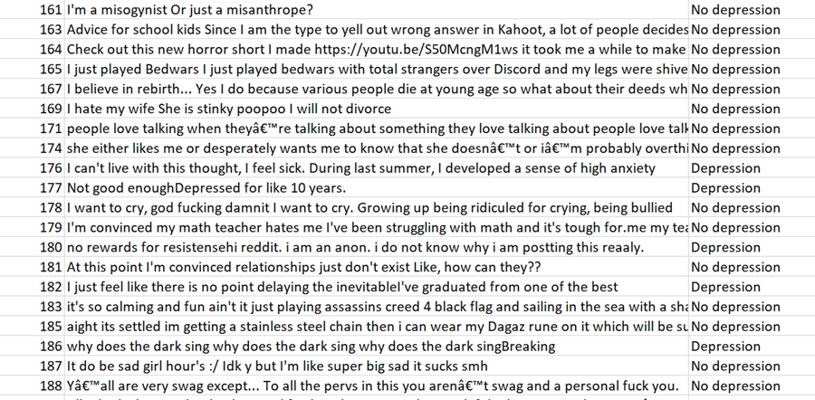
Data Sources
DAIC WOZ (Distress Analysis Interview Corpus),
Publicly available labelled depression dataset on Kaggle

Slide 7
Text Preprocessing & Feature Extraction
01
02
03
Lower Casing
Stop Word Removal
Stemming using NLTK
04
Text -> numerical representations using TF IDF.
Why TF-IDF?
Transparency
Ease of interpretation
Lower risk of hallucination compared to generative models
Compatibility with classical machine learning classifiers.

Slide 8
Model Training
Multiple classical machine learning models were evaluated during experimentation, including
Naive Bayes
Decision Trees
Random Forests
K Nearest Neighbors
Gradient Boosting

Slide 9
Model Selection
We selected Naive Bayes model as the final one which is a trade off between performance and system level safety requirements.
Rather than optimizing for maximum accuracy alone, preference was given to models whose behavior could be more easily reasoned about by system designers and clinicians

Slide 10
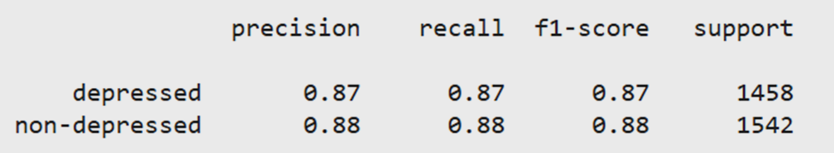
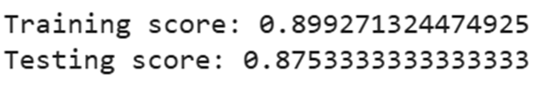
Model Evaluation

Slide 11
Scope of Implementation
The prototype implements the complete decision support pipeline, including:
A frontend interface for clinicians to manage patients and sessions
Backend services for authentication, session handling, and data storage
A dedicated AI inference service for depression risk prediction

Slide 12
Frontend Interface
The React-based frontend serves as the main interaction layer for clinicians, supporting secure authentication, patient management, session-based text input, and review of past sessions. AI outputs are presented within sessions as probabilistic risk indicators, clearly separated from clinical diagnoses or recommendations

Slide 13
Backend Architecture
Node.js + MongoDB
Node.js backend orchestrates clinical workflows, secure authentication, and data persistence, independent of ML inference
MongoDB storage separates psychologists, patients, and sessions to support structured, longitudinal clinical tracking
JWT-based access control ensures only authorized clinicians can access patient records and AI outputs.

Slide 14
AI Inference Service (FastAPI)
The AI model is deployed as a standalone FastAPI service. The service defines a structured input schema, applies the same preprocessing steps used during training, and returns model predictions in real time
The inference service operates locally to reduce privacy risks associated with transmitting sensitive mental health data

Slide 15
Model Integration into the System
FastAPI inference service deploys the serialized Naive Bayes model and TF-IDF vectorizer, exposing a /predict endpoint for text-based risk prediction.
End-to-end preprocessing is applied at inference time, transforming input text and returning predicted risk labels.
Stateless AI component performs prediction only, storing no data and providing outputs solely as clinician-facing decision support signals.

Slide 16
Testing & Evaluation
Model Performance
Safety Oriented Testing
Fairness & Bias Considerations
Robustness & Input Sensitivity Testing

Slide 17
Deployment & Reproducibility
Fully local deployment
Reproducible pipeline
Modular Components

Slide 18
Conclusion
This project demonstrates that AI can be responsibly integrated into mental health assessment when it is explicitly designed as a human in the loop decision support system, with carefully defined boundaries between automated analysis and human judgment

Slide 19
Future Works
Real Clinical Trials
Linguistic Variation

Slide 20

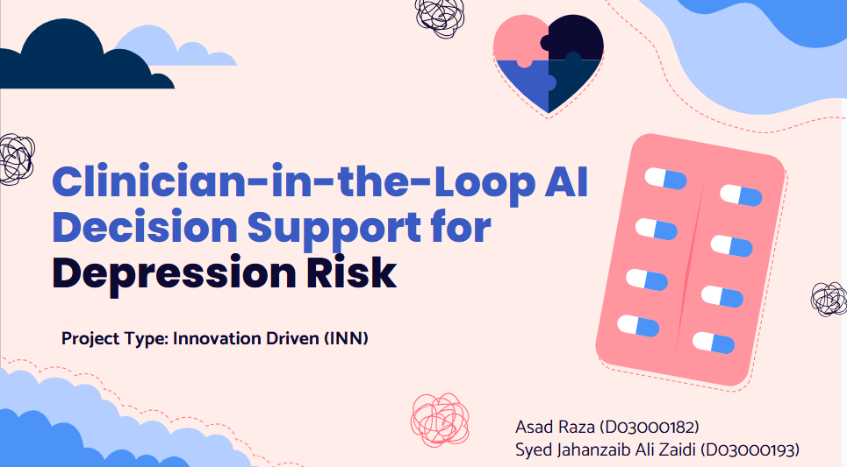

Github Link

Slide 21
Important Links
https://dcapswoz.ict.usc.edu/daic-woz-database-download/
https://www.kaggle.com/datasets/nikhileswarkomati/suicide-watch
https://ieeexplore.ieee.org/document/9591887

Slide 22
Thank You!

